Slide 1


SmrtComp: Intelligent and Online CAN Data Compression
Dipika Tanwar, Priyanka Singla, Soham Nag, Vireshwar Kumar, and Smruti R. Sarangi
Indian Institute of Technology Delhi (IIT-Delhi), India
1

Slide 2
Introduction

Slide 3


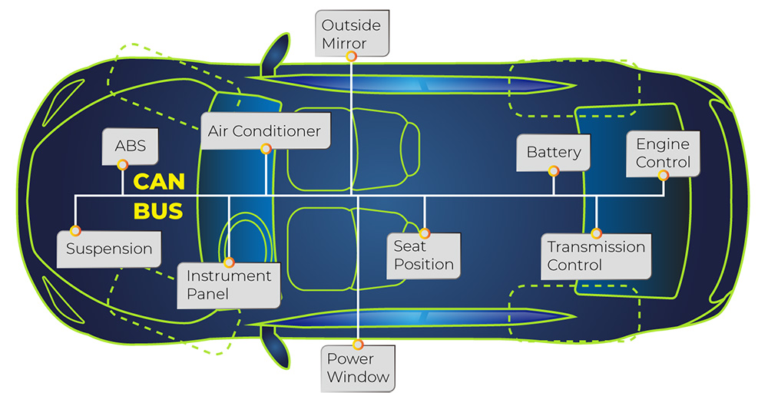




Modern Vehicles
On-board diagnostics
3
Performance monitoring
Cause of accidents
CAN data
Driving pattern analysis
100+ Electronic Control Units (ECUs)
Cyber-attack detection
Controller Area Network (CAN) is the de-facto for ECUs communication
Courtroom evidence

Slide 4



Storing CAN Data
Increase storage
FRAM is expensive
How to store large amount of data (~500kbps)?
Periodically store it externally
Not scalable, cost ineffective
Compress and store
Lossless
Lossy
+ No information loss
Limited compression gain
+ High compression gain
High information loss
Can we have best of both worlds, ensuring data quality?

Slide 5


Storing CAN Data
How to store large amount of data (~500kbps)?
Compress and store
How long should the data be stored?
Can we have an intelligent compression algorithm?
Often need ~250 hrs of data[1]
Can we store data at line speed?
Can we have best of both worlds, ensuring data quality?
Data generation rate: ~500kbps
Can we have a fast enough algorithm?
1. Y. Qiu, T. Misu, and C. Busso, “Driving Anomaly Detection with Conditional Generative Adversarial Network using Physiological and CAN-Bus Data,” in IEEE Trans. Inf. Forensics Secur., vol. 16. ICMI, 2021, pp. 4133 – 4146.

Slide 6
Proposed Work
Introduction

Slide 7

SmrtComp
Can we have best of both worlds, ensuring data quality?
Pre-decided Qos
SmrtComp:
Intelligent compression decisions
Can we have an intelligent compression algorithm?
Efficiently use available storage
Can we have a fast enough algorithm?
Fast online compression

Slide 8
CAN Data
MacroFrame
Accel Pedal
Brake Pedal
Steer Angle
Vehicle Speed
Gear
Engine RPM
…..
Signals
Timestamp | AccelPedal | BrakePedal | SteerAngle | .....
timestamp | value | value | Value | …
←Entry
Entry
Frame

Slide 9
SmrtComp
Streaming databases use the same notion
2.Efficient use of available storage
1.Pre-decided Qos
3.Fast online compression
α
β
α
Discard
Lossless
Tunable lossy compression
Discard
Lossy compression
Compression level
β
Lossless compression
Data age
α -> threshold to discard very old data
β -> threshold to preserve recent data

Slide 10
SmrtComp
Deflate: fast compression method with good compression gain
2.Efficient use of available storage
1.Pre-decided Qos
3.Fast online compression
RAM
External Memory
Macro frame
A) Macro frame creation and logging
B) Continuous monitoring and recompression of the log
Size == Frame size?
Lossless compression
Size == MFsize?
Log

Slide 11
SmrtComp – Log Recompression
2. Continuous monitoring and recompression of the log
RAM
External Memory
 |  |  | X
PCA
DCT
 |  | X
 | X | X
Principal Component Analysis: Dimensionality reduction; capturing majority of data’s variance
Discrete Cosine Transformation: Removes lower-valued coefficients without affecting the data quality
For subsequent recompressions, only DCT threshold is increased, based on MF’s age (No PCA)
Size > log_{max}?

Slide 12
Evaluation
Proposed Work
Introduction

Slide 13
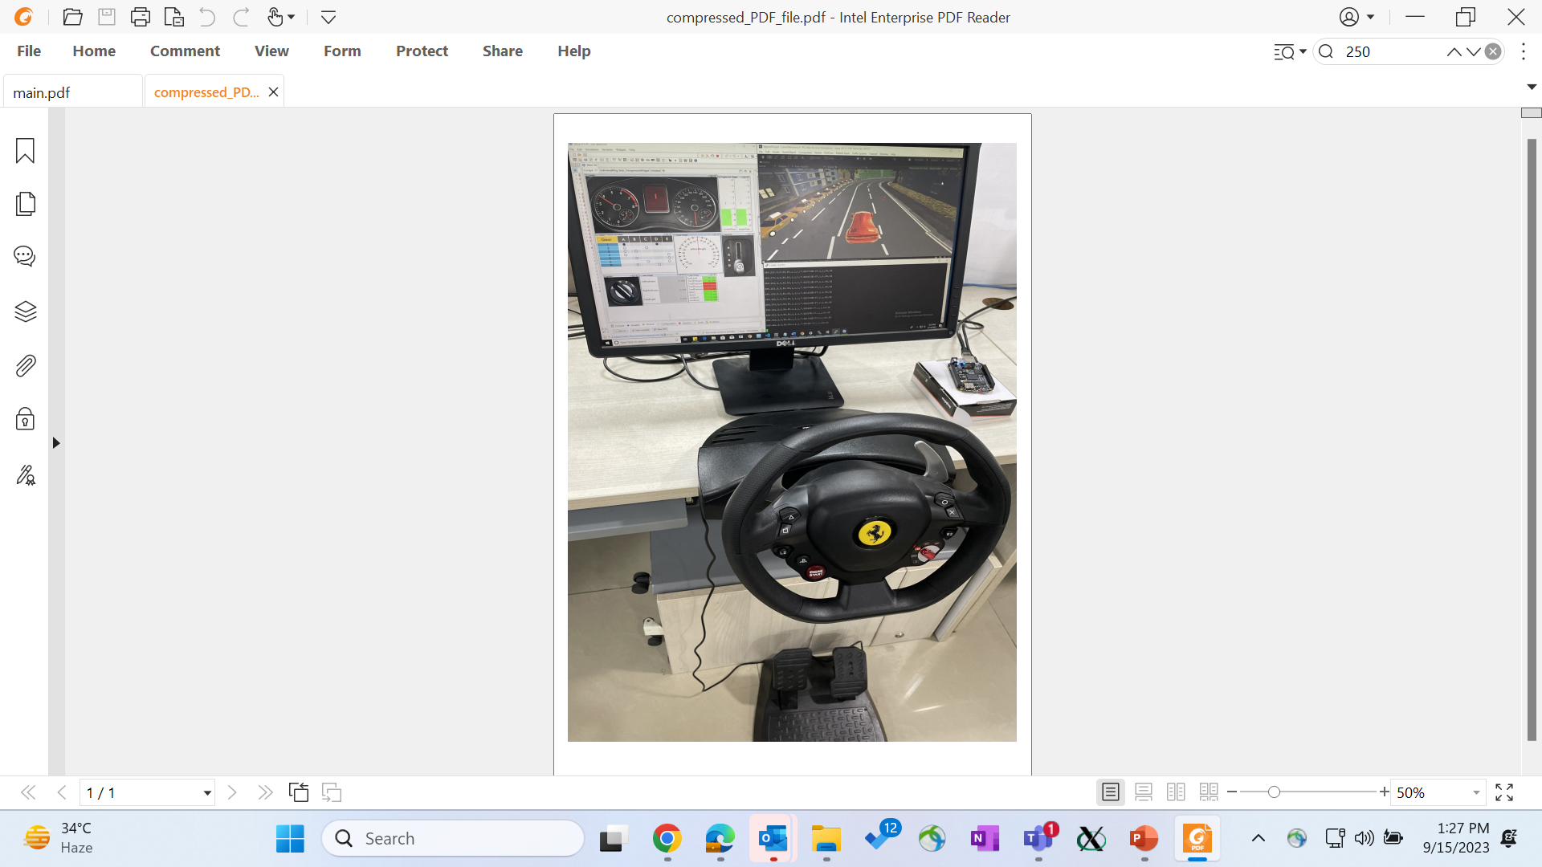
Experimental Setup
Dataset
Driving Pattern
Integrated Carla and Unity game to Silver
Source
Used to simulate car’s internals
Unity car
Normal
Unity car game
(Realistic driving)
game
Rash
Silver
GUI
Carla
Autonomous
Literature
Real
Embedded board
-CAN bus bandwidth: 500 kbps
-Embedded board: 1GHz, ARM Cortex-A8 processor; 512 MB RAM, 4GB log size
-Frame: 20KB and Macro frame: 32MB
Steering, break, and accelerator
Metrics:
Compression gain: original_size/compressed_size
RMSE: Root mean square error

Slide 14
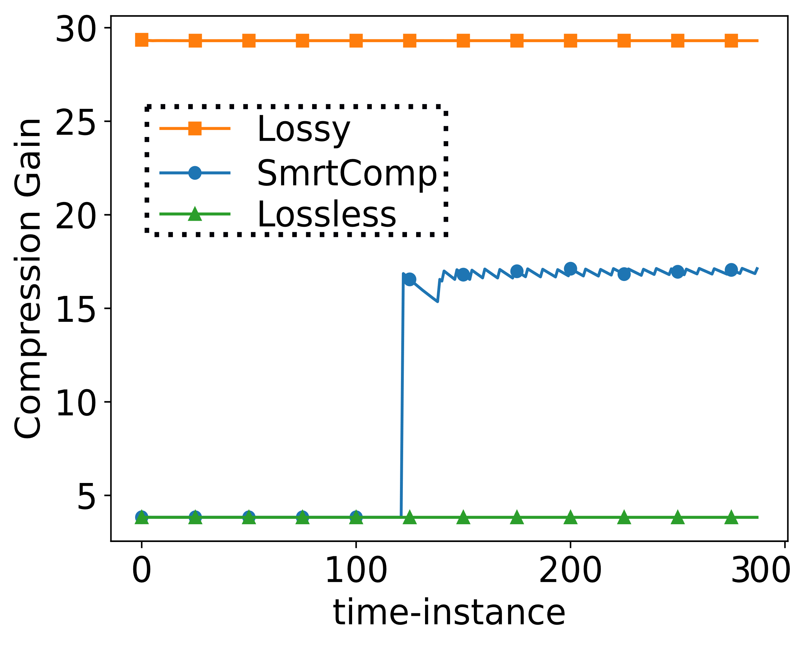
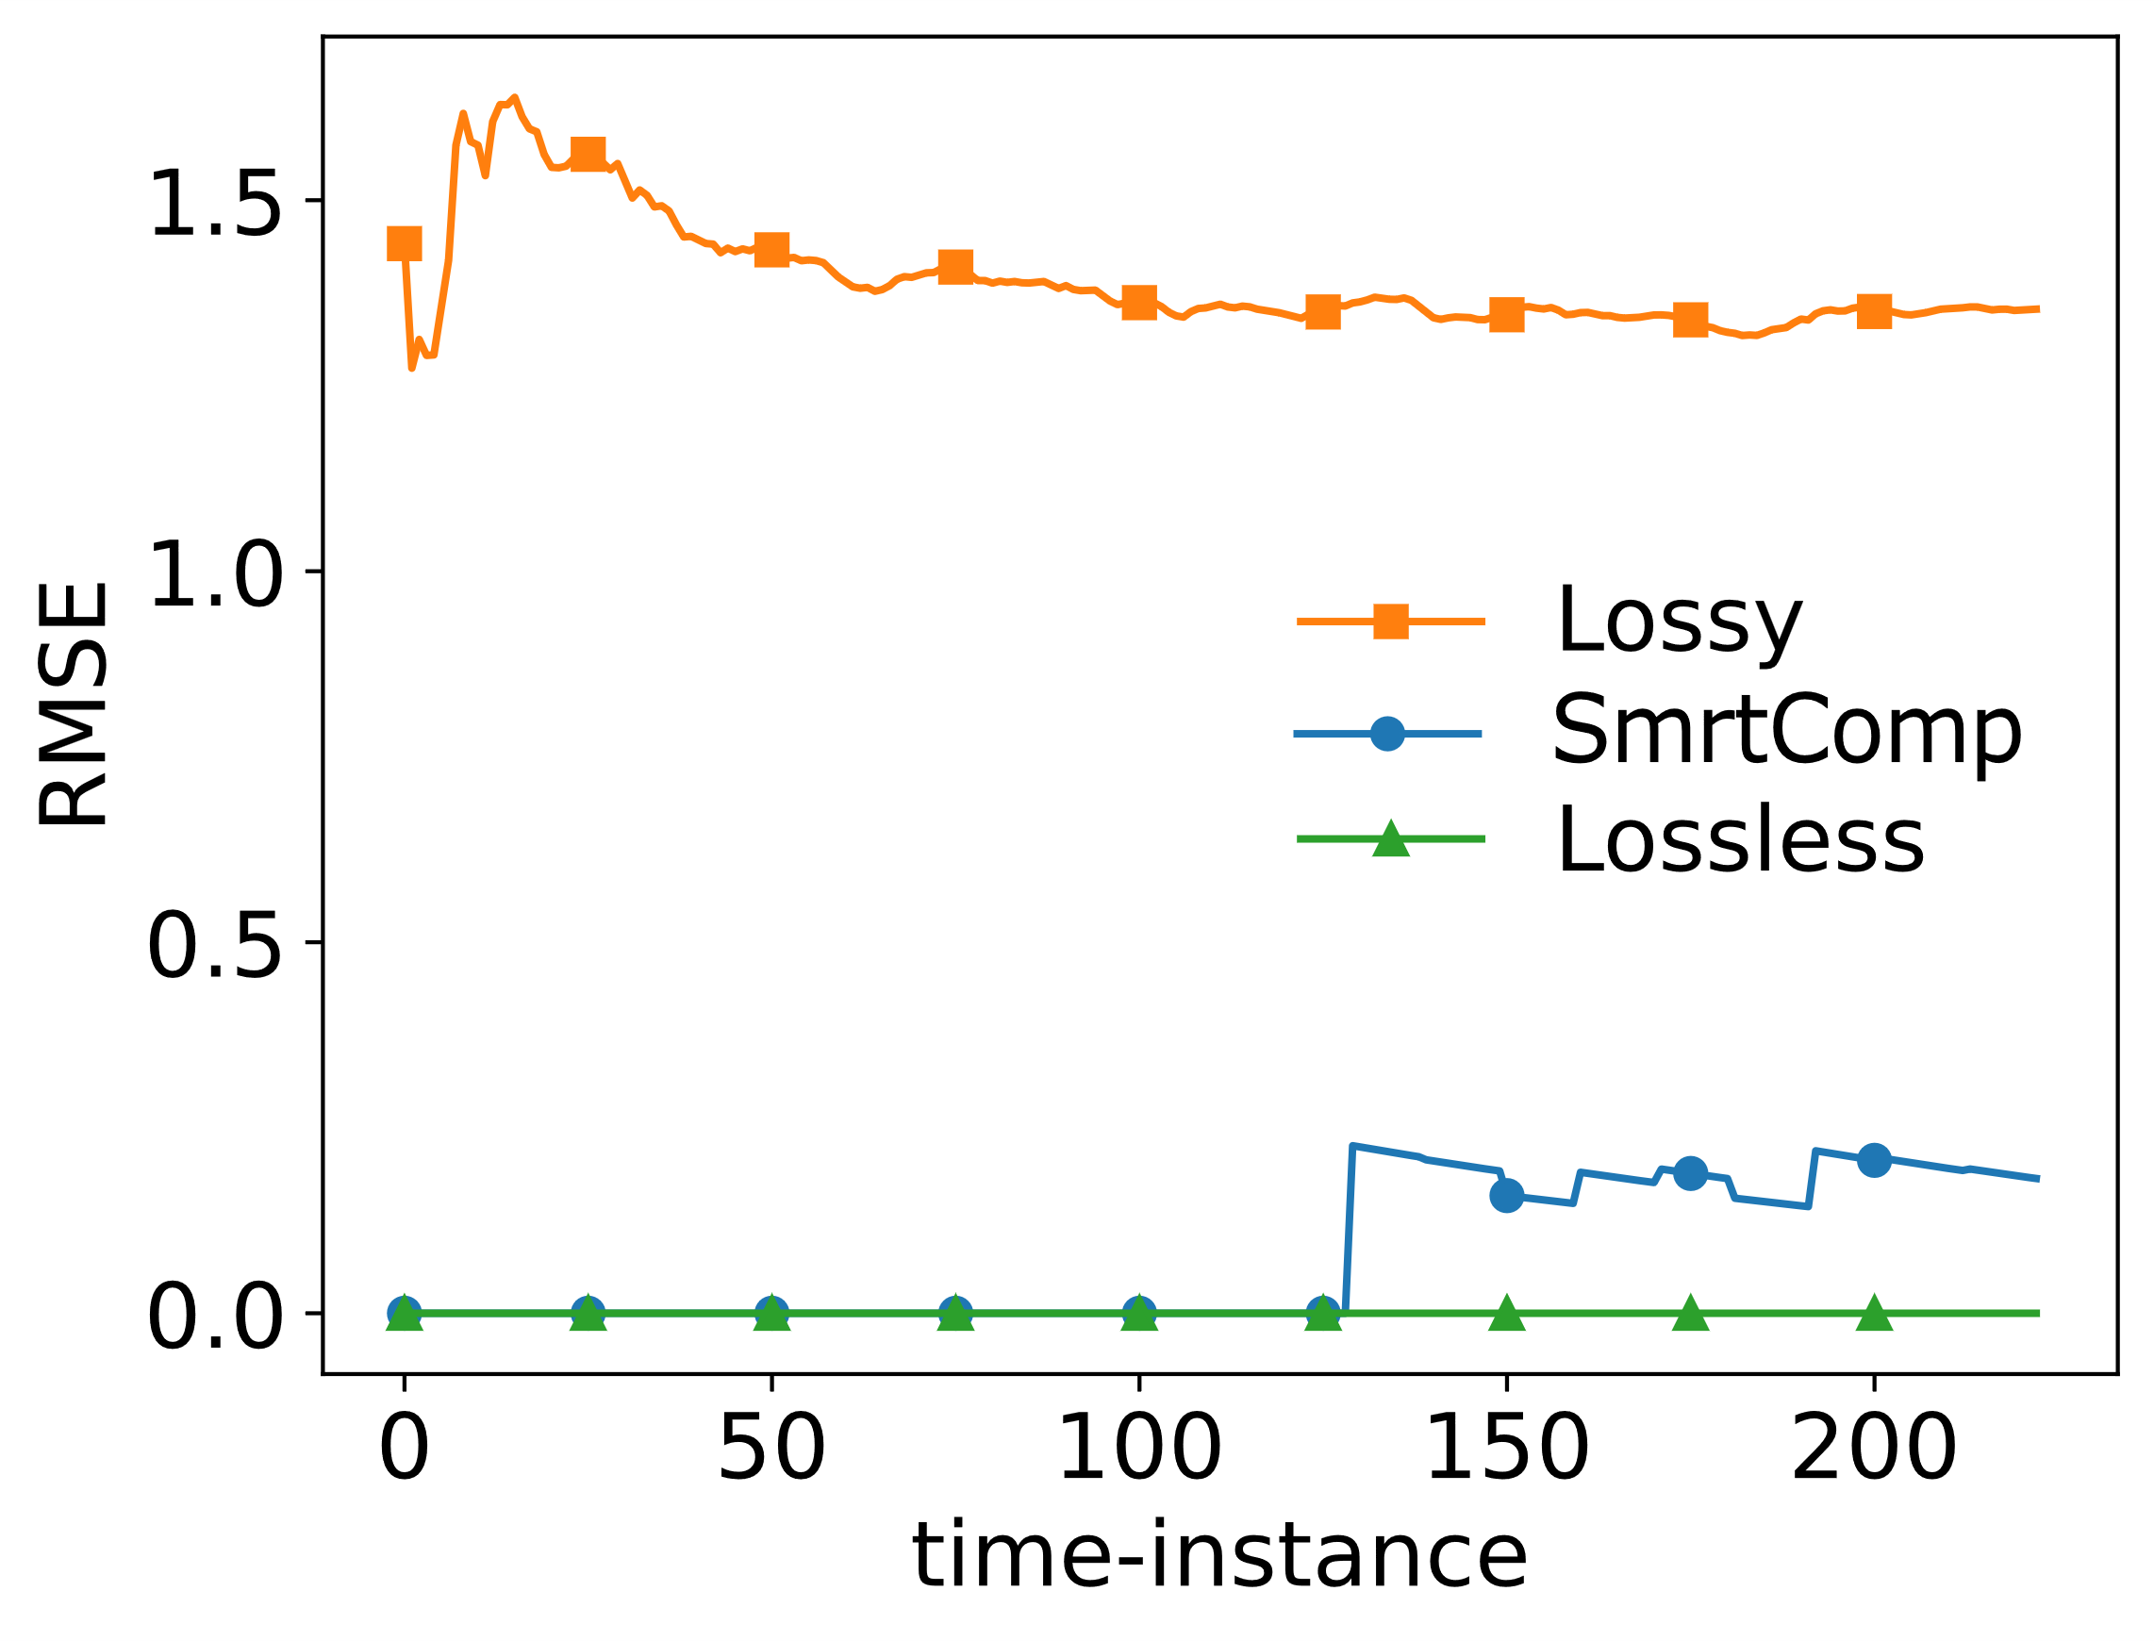
SmrtComp’s Efficacy
~5X
3.4X
No of MF stored (4GB log size, data rate- 500kbps)
Algorithm | #of MFs stored | Sufficient amount of data? | Good data quality?
Lossless | 128 (3 days) | No | Yes
Lossy | 800 (~20 days) | Yes | No
SmartComp | 400 (~10 days) | Yes | Yes

Slide 15
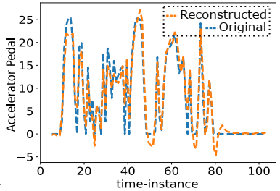
SmrtComp’s Accuracy
Accurate reconstruction of data
Preserving vital features
Compared anomalies preserved at different compression levels
1-10 levels: 80% space gain with only 15% increase in misclassifications
>10 levels: misclassifications increased to 40% -> not useful

Slide 16
Conclusion
Evaluation
Proposed Work
Introduction

Slide 17
Conclusion
First work to store CAN bus data in a hybrid fashion (lossless + lossy)
Amount of information loss (based on compression levels) in data varied without uncompressing
SmrtComp compresses and stores CAN data at line speed
Considering 4GB of storage, can store data continuously for 10 days

Slide 18

Questions
Contact:
priyanka@sit.iitd.ac.in
http://www.cse.iitd.ac.in/~priyankas/

